Slide 1
SAP Process Integration Overview

Slide 2
Table of Contents
SAP Landscape Overview
1
What is Middleware
2
Process Integration Overview
3
Logon Process and Basic Navigation
4

Slide 3
1. SAP Landscape Overview
SAP landscape is the arrangement for the server system such as Development server, Quality server, and Production server
Development server:
Requirement Gathering
Scenario Creation
Unit Testing
Quality server:
End to End Testing
Production server:
Recorded the live data post Go-Live

Slide 4
What is Middleware
Middleware used for to exchange the data between the different systems
Sits "in the middle" between applications that may be working on different operating system.
It makes the maintenance of Integration between systems easier for any Large organization, being a single point to monitor all issues.
Middleware Tools- Cloud Platform Integration, MuleSoft, TIBCO, Dell-Boomi.

Slide 5
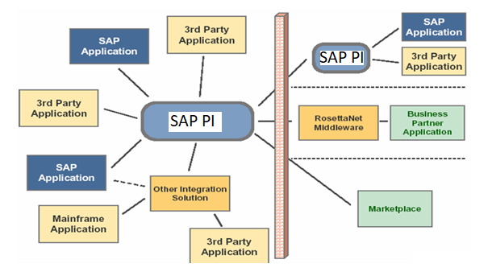
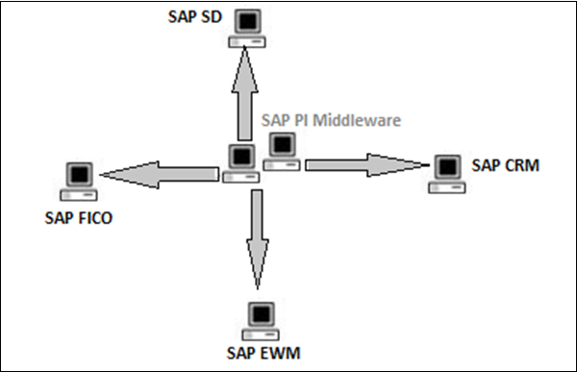
4. Process Integration Overview
Connect different applications or systems in a distributed environment
For integrating both SAP and non-SAP applications
For both internal (A2A) and external (B2B) process integration
Central configuration, monitoring and error handling

Slide 6
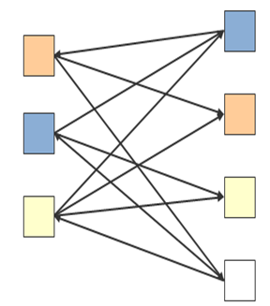
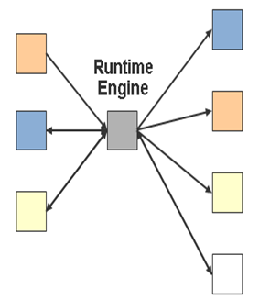
Evolution - Need of PI
Point-to-Point Communication
Compare the adjoining figures w.r.t. below points and evaluate which is better mode of communication
Complexity
Maintenance
Upgradability
Mediated communication is better option
PI uses special format of XML called PIXML for all its internal communications
Mediated Communication

Slide 7
Evolution – XI -> PI -> PO
Formerly it was called as EXchange Infrastructure (XI) as it was basically meant for exchanging messages between applications
Based on the architectural changes which it underwent over the years for widening of scope of integration, it was named as Process Integration (PI) as it facilitated integrations of cross-component processes
In the recent change on the deployment options on the application server where it allows deployment of three components (PI, BPM, BRM) of NetWeaver on the same server with same SAP system ID it is also termed as Process Orchestration (PO)
XI 7.0 2005
PI 7.1
2007
PI 7.3
2010
PO 7.4 2013
PO 7.5
XI 2.0 2002

Slide 8
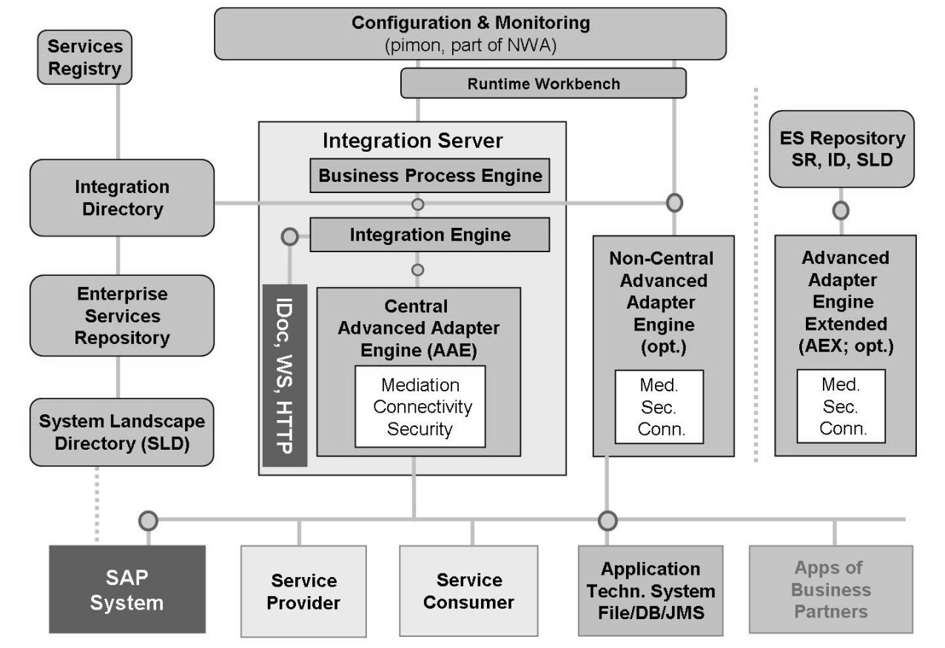
Architecture - What does it consist of ?
PI is collection of components, that work together flexibly to achieve process integration
Based on the integration phase in which they are used, components are also classified into three categories
Design Time : ESR, SLD
Configuration Time : ID, SLD
Runtime : SLD, Integration Server, Runtime workbench.
System Landscape Directory (SLD) contains information about the Landscape (Technical Systems and Business Systems) and the Software Catalog (Product and Software Component Versions).

Slide 9
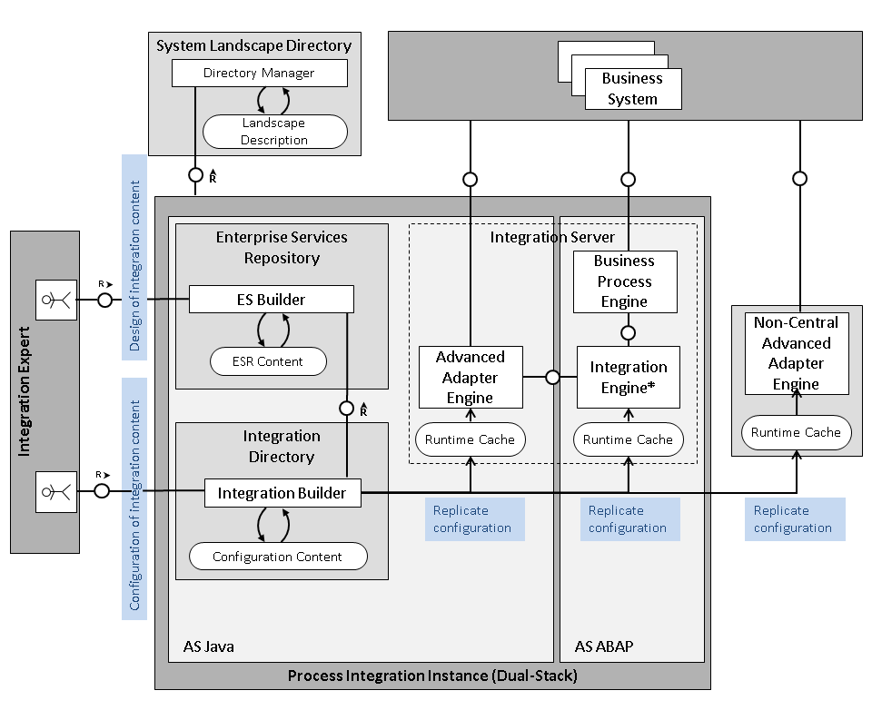
Architecture - What does it consist of ?
Enterprise Services Repository contains design objects like interfaces, mappings, process definitions.
Integration Directory is used to configure the scenarios for the message exchange
There are two ways in which PI can be installed
Dual Stack
Single Stack/Stand Alone
Dual Stack installation utilizes both WebAS ABAP and WebAS JAVA servers for integration, where Advanced Adapter engine is deployed on Java stack while Integration Engine and Business Process Engine is deployed on ABAP stack as shown in adjoining figure

Slide 10


